Slide 1
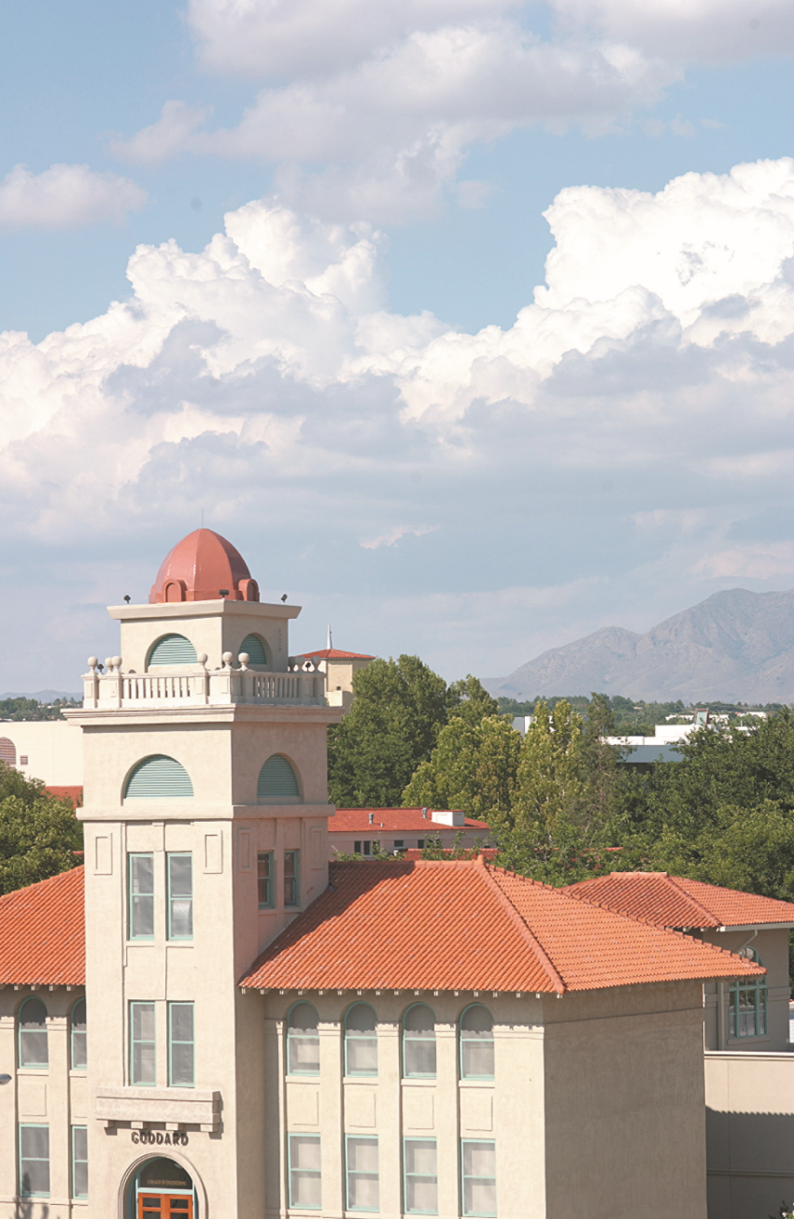


College of Engineering
ABET Review
October 1, 2018
Lakshmi N. Reddi
Dean, College of Engineering

Slide 2
College of Engineering Strategic Plan
Goal 1: Provide Innovative Educational and Research Programs
Goal 2: Promote Faculty and Staff Success
Goal 3: Promote Student and Alumni Success
(3 Gs – Get the degree, Get a job, and Give back)
Goal 4: Support Research and Creative/Scholarly Activity
Goal 5: Enhance Outreach and Cooperative Extension
Goal 6: Develop and Diversify Gifts
Goal 7: Increase Visibility and Ranking
Goal 8: Promote Access, Diversity and Internationalization

Slide 3
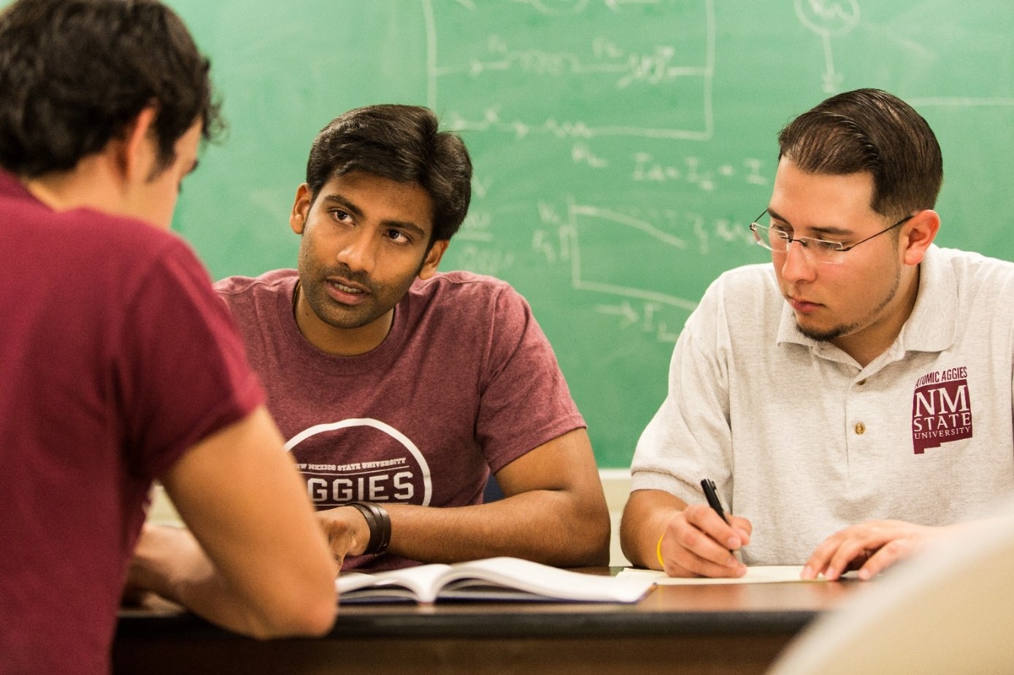
Student-Centered Programs
  Learning Communities: student support,
  professional development, tutoring
  Interdisciplinary, industry sponsored
  capstone design projects
  24 Engineering student organizations
  Undergraduate research opportunities
  National student chapter competitions
  Aggie Innovation Space
  Arrowhead Park: assistance for
  entrepreneurs
  Internships, co-ops, employment fairs

Slide 4
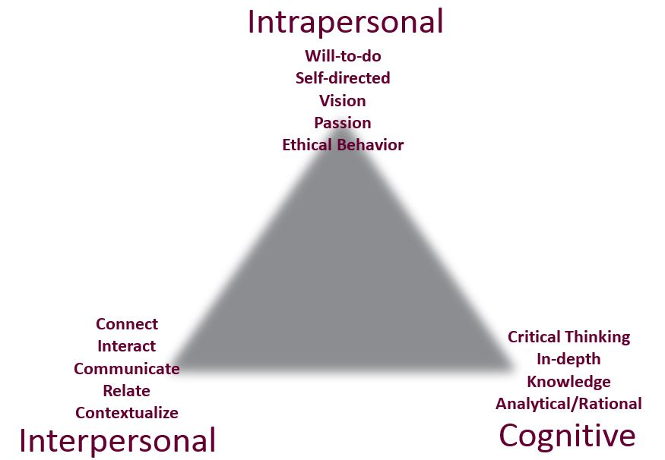
Engineering Leadership Institute

Slide 5
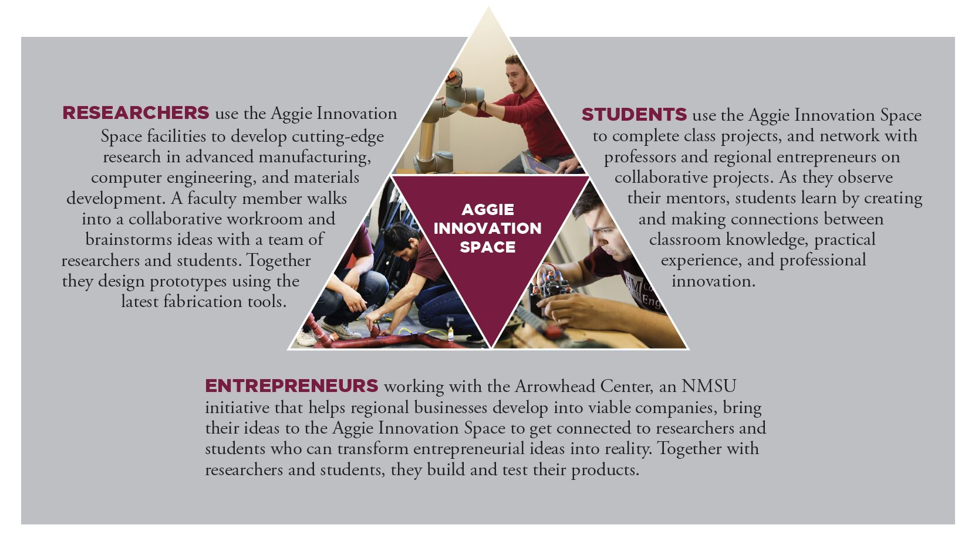
Aggie Innovation Space

Slide 6
Eloy Torres Family Learning Communities
Increase student retention–more students will advance
rather than changing majors or dropping out.
Ensure more students graduate and become engineers.
Graduate students in less time.
Exceed current NMSU
averages for retention
and graduation rates.

Slide 7
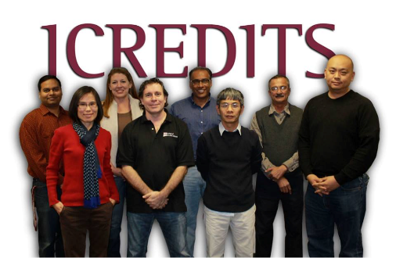




Centers of Engineering Research
ReNUWIt: Re-inventing the Nation’s Urban Water Infrastructure
iCREDITS: Interdisciplinary Center of Research Excellence in Design of Intelligent Technologies for Smart Grids
CBBG: Bio-Mediated and Bio-Inspired Geotechnics
Tran-SET: Transportation Consortium of South-Central States

